Slide 1

APES
Biogeochemical
Cycles

Slide 2
Nutrient Cycling – Biogeochemical Cycles
Building blocks of life macronutrients (CHOPNS)
  Carbon → base for organic life forms; carbohydrates, proteins, nucleic acids, lipids
  Hydrogen → hydrogen bonding (only with N, O, and F)
  Oxygen → aerobic respiration
  Phosphorus → limiting factor in aquatic systems; teeth and bones; ATP
  Nitrogen → DNA, proteins; plant nutrient; limiting factor in marine systems
  Sulfur → DNA, proteins
Types of Cycles
  Gaseous → C, O, N, S, H₂O
  Sedimentary → P

Slide 3
Carbon Cycle
Photosynthesis - main mechanism to fix carbon into a useable form
  CO₂ + H₂O C₆H₁₂O₆ + O₂
  Energy is consumed, carbohydrates are produced, oxygen is given off as a waste product
Aerobic Respiration
  C₆H₁₂O₆ + O₂ ---→ CO₂ + H₂O
  Energy is produced, oxygen is consumed and CO₂ is put back into the atmosphere
Decomposition
- Carbon based lifeforms decay into carbon compounds – become part of dirt over time – fossils- fossil fuels
Average Residence Time
  Atmosphere → 3 years (mainly as CO₂ gas)
  Soils → 25 – 30 years (Carbonate sediments, rocks)
  Ocean → 1500 years (marine sediments, oceans)
hν
Linked and needed for one another. Mini-cycle

Slide 4
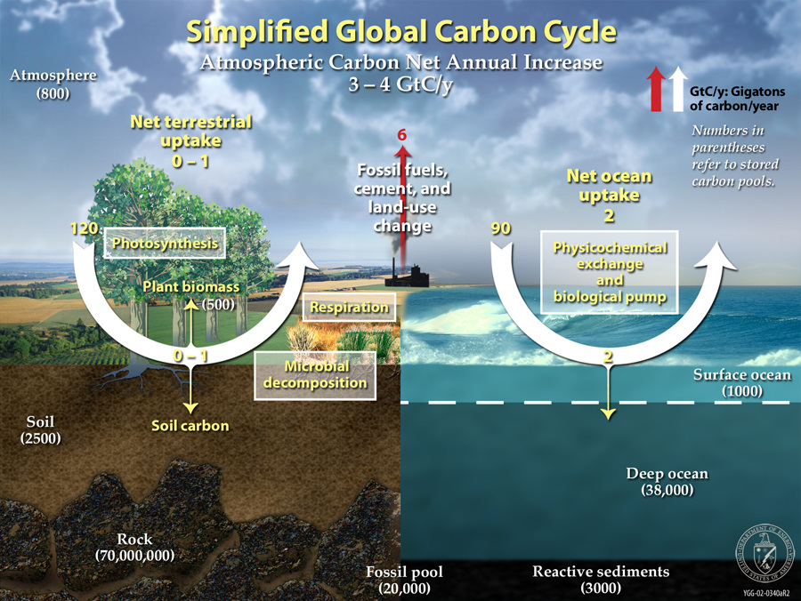
Carbon Cycle
Sinks- reservoirs of carbon sequestration- carbon storage
Sources- Creation of carbon through manipulation/transformation of previous carbon based chemicals.

Slide 5
Human Impacts on the Carbon Cycle
New Carbon vs. Old Carbon
Deforestation
    Loss of a carbon sink
    Slash and burn techniques= combustion of carbon gas
Disturbance of soil
  – releases amount of carbon into the atmosphere
Combustion of Fossil Fuel
  H_{x} C_{y} + O₂ → CO₂ + H₂O (Complete combustion)
Ocean Acidification – largest carbon sink – less ability to hold CO₂
Climate Change
  Warmer oceans – may release more CO₂, increases in CO₂ can increase the acidity of the oceans
  Warming permafrost can release more CH₄

Slide 6
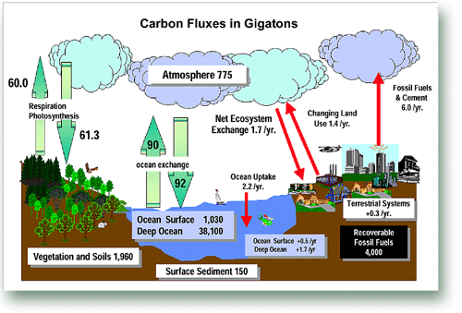
Anthropogenic Changes

Slide 7
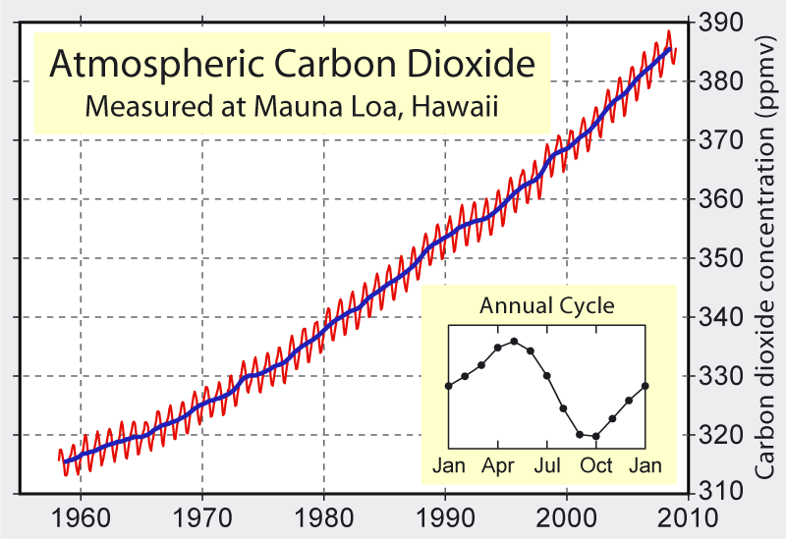
Carbon dioxide Concentrations

Slide 8
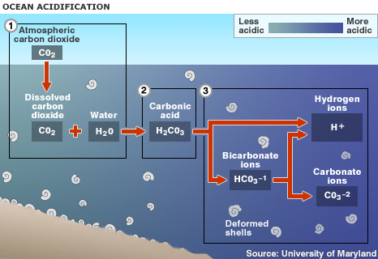
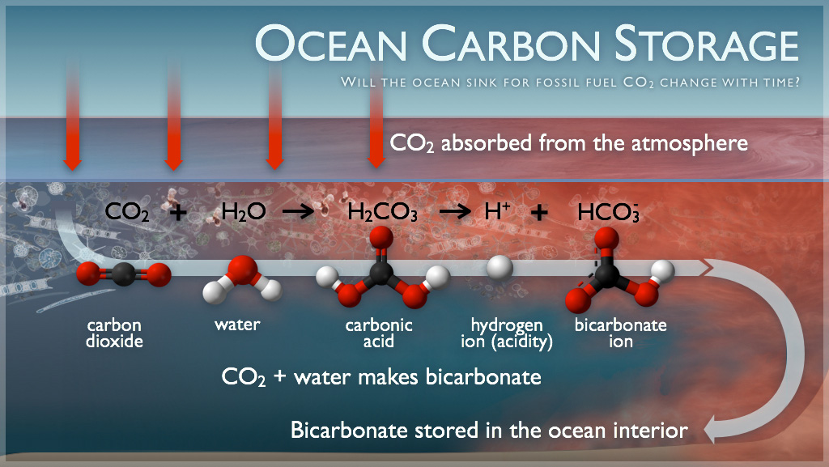
Draw backs = increased acidification of oceans because of dissolved carbon dioxide
Oceans store Carbon
Deep sea species use that to create their calcium carbonate shells

Slide 9
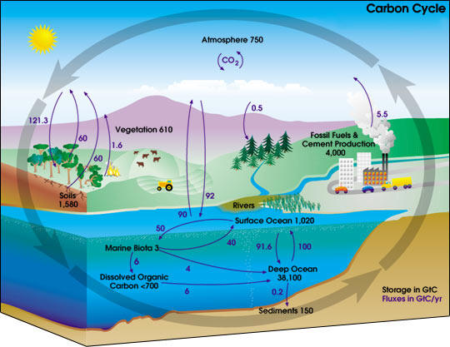
Carbon Cycle with Global Flux

Slide 10
Nitrogen Cycle
Major store – atmosphere (molecular nitrogen – N₂)
Limiting nutrient in marine ecosystems
Nitrogen fixation – atmospheric nitrogen is converted into NH₃
  Abiotic - N₂O, HNO₃
  Biotic
    Rhizobium bacteria – found in the root nodules of legumes
    Azotobacter
    Cyanobacteria
Nitrification (NH₃ to NO₂⁻ to NO₃⁻)
  Nitrosomas – ammonia to nitrite ions
  Nitrobactor – nitrite to nitrate ions
Assimilation
  Ammonium and nitrate ions by plants through their roots. DNA, proteins, amino acids (ionic)
  Animals assimilate nitrogen by eating plants (organic)

Slide 11
Nitrogen Cycle Con’t
Ammonification
  Nitrogenous wastes and organic matter are broken down by decomposers
  NH₃ is produced
Denitrification – anaerobic bacteria
  Ammonia and nitrates are broken down by denitrifying bacteria
  N₂ and N₂O are produced
Human Impacts
  Combustion of fossil fuel –NO_{x} →photochemical smog, acid rain
  Fertilizers (Haber cycle) – nitrogen runoff, excess nutrients → eutrophication → algae blooms → dead algae are decomposed → declines in DO → potential death of fish; N₂O into the atmosphere → N₂O is both a greenhouse gas and an ozone depleting compound
  Planting excessive nitrogen-fixing crops
  Runoff from feedlots - manure

Slide 12
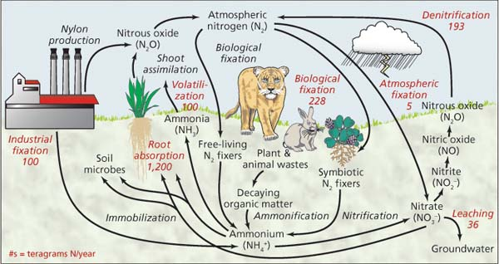
N₂ Cycle with Fluxes

Slide 13
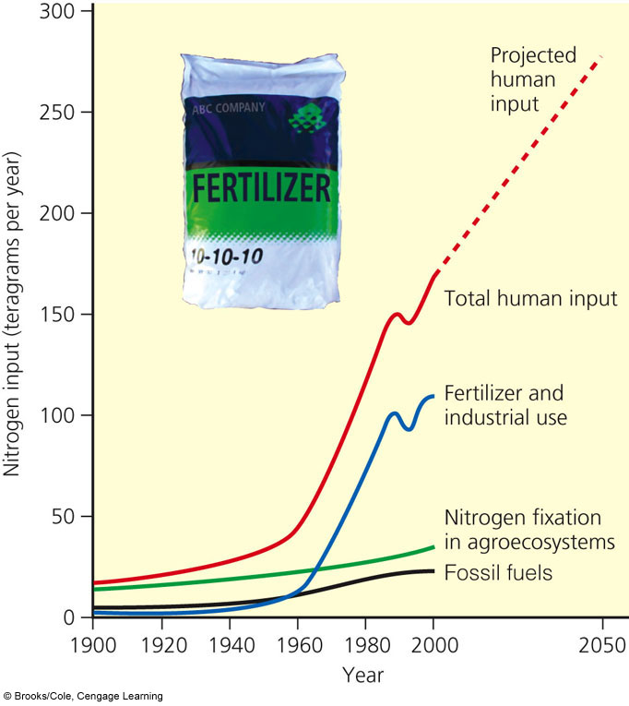
Increases in Nitrogen due to Anthropogenic Sources

Slide 14
Sulfur Cycle
Gaseous Cycle
Major Store – rocks – Fe₂S or CaSO₄
Natural Sources
  Volcanoes – SO₂ → H₂ SO₄
  DMS – dimethyl sulfide from the ocean
  H₂S from decay
Human Impacts
  Combustion of coal and petroleum release SO_{x} → leads to the formation of H₂SO₄ → contributes to the formation of acid rain
  Smelting operation
  Ice core samples → large increase in S since the industrial revolution

Slide 15
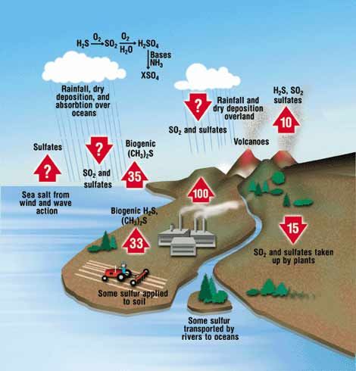
Sulfur Cycle

Slide 16
Phosphorous Cycle
Sedimentary Cycle
Major Stores
  Phosphate rock
  Marine sediments
Mined as the mineral apatite – Ca₃(PO₄)₂ (largest mine near Tampa, FL)
Guano
Limiting nutrient in freshwater ecosystems
Fixed by mycorrihizae fungi (keystone species)
Human impacts
  Removing phosphorous faster then it can be replenished in through the phosphorous cycle – non renewable resource
  Fertilizers → Excess nutrients → eutrophication → algae blooms → dead algae are decomposed → declines in DO → potential death of fish
  Phosphate containing detergents

Slide 17
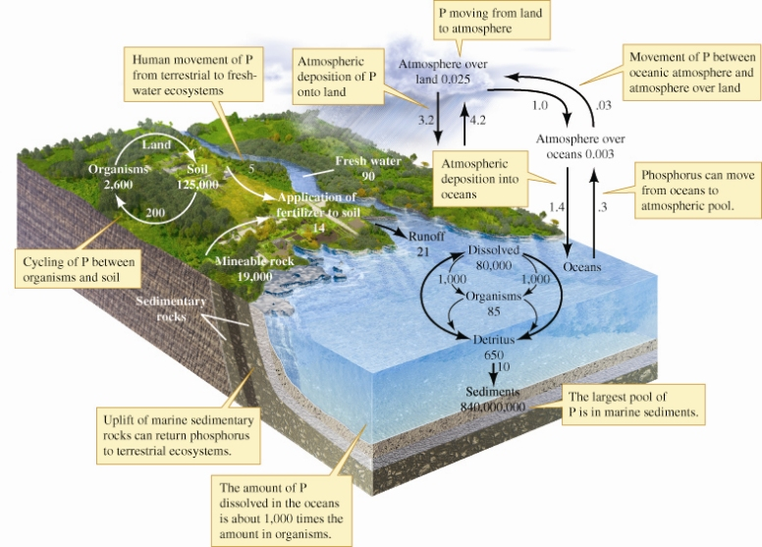
Phosphorous Cycle with Fluxes

Slide 18
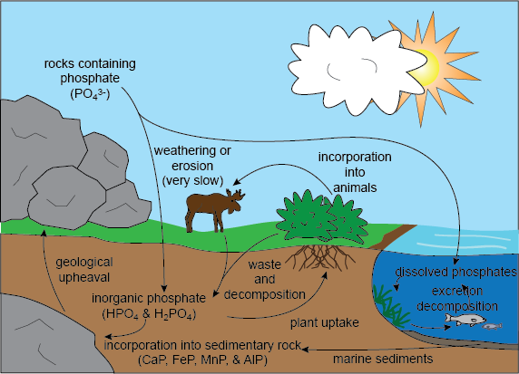

Slide 19
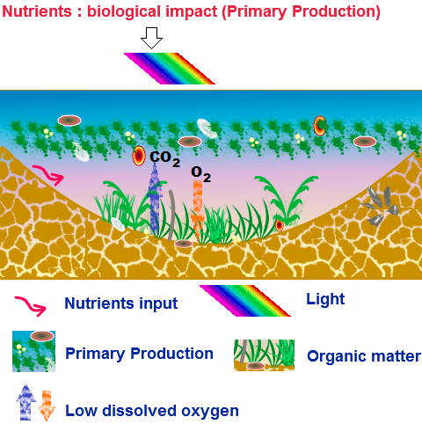
Nitrogen and Phosphorous
Nutrient rich water entering a wetland may result in increased primary production which, in turn, may alter the light conditions for submerged aquatic plants, sometimes to the point where they cannot survive. This may lead to a complete change in the ecology of the wetland from one dominated by submerged macrophytes to one dominated by phytoplankton. This has numerous flow-on effects on the biota of the wetland. The death of submerged plants leaves a large pool of organic matter to be decomposed, greatly reducing dissolved oxygen levels.

Slide 20
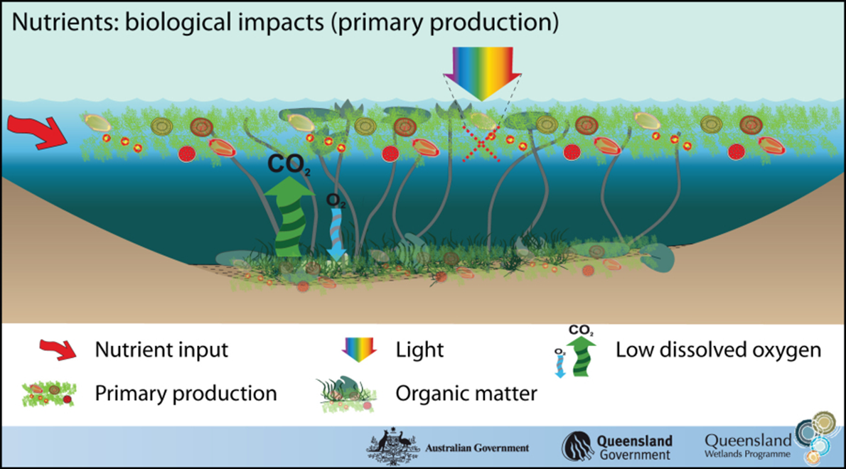

Slide 21
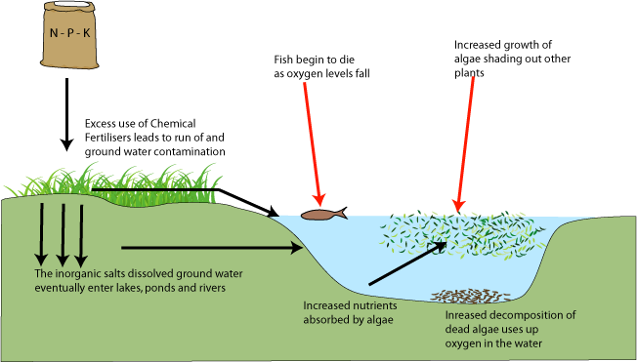
Eutrophication
is the enrichment of an ecosystem with chemical nutrients, typically compounds containing nitrogen, phosphorus, or both.

Slide 22
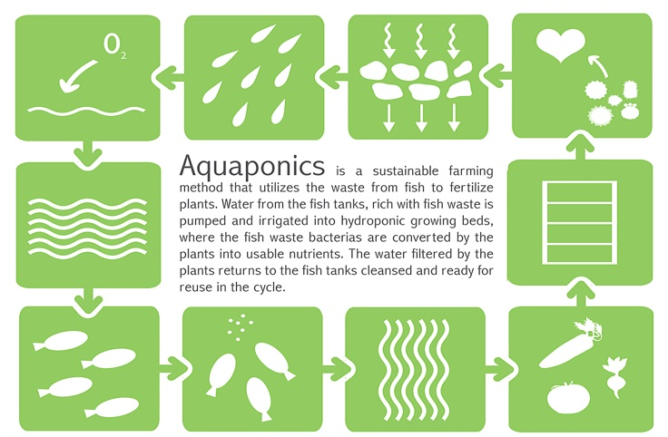

Slide 23
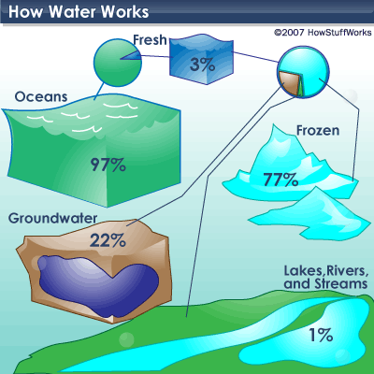
Hydrologic Cycle
Driven by the sun and gravity
71% of the earth’s surface is covered by water
~97 % is salt water (average salinity is 35 ppt or 3.5%
~3% is fresh water
~.024% is available for consumption

Slide 24
Hydrological Cycle
Evaporation (conversion of water into water vapor after heated)
Transpiration (evaporation from leaves (stoma) of water extracted from soil by roots and transported throughout the plant)
Condensation (conversion of water vapor into droplets of liquid water)
Precipitation (rain, sleet, hail, snow)
Infiltration ( water percolates through porous soil)
Runoff ( water that does not go through impervious surfaces flow over towards areas of low elevation)
Percolation (downward flow of water through soil and permeable rock formations to groundwater storage areas called aquifers

Slide 25
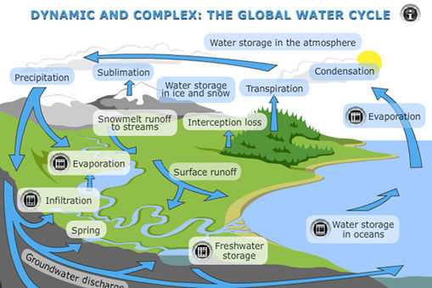

Slide 26
Hydrologic Cycle Con’t
Human Impacts
Groundwater Depletion
Clearing Vegetation
Dams and water diversion projects
Impervious surfaces in urban areas

Slide 27
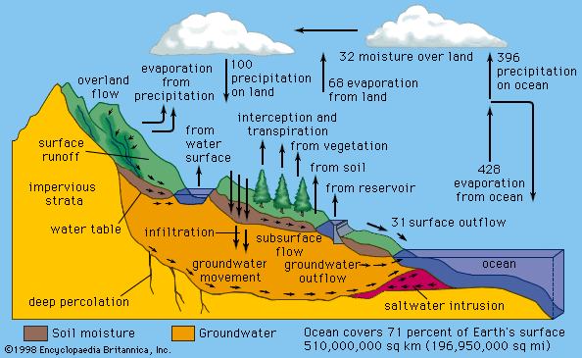
Hydrologic Cycle

Slide 28
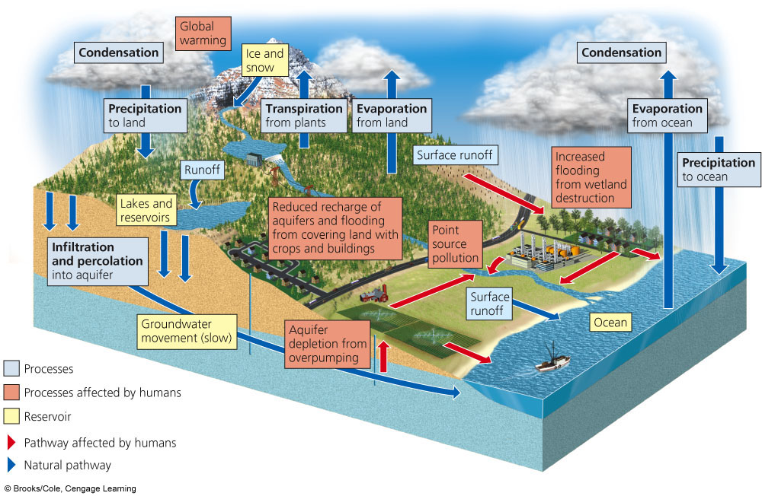
Hydrologic Cycle with Human Impacts

Slide 29
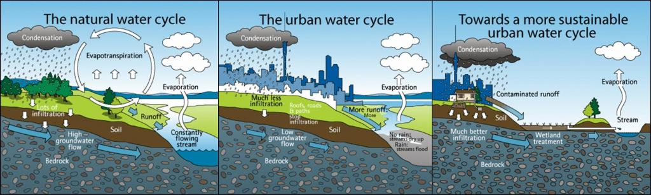
Urban areas have now started to realize that aquifers will not replenish without permeable surfaces.
Cities out west have also now banned the use of rain barrels

Slide 30
Geological Cycles
The rock cycle- involves the cycling of rocks into soil or back into rock forms – igneous, sedimentary, metamorphic
Driven by Tectonic plates as well as water ( weathering)

Slide 31
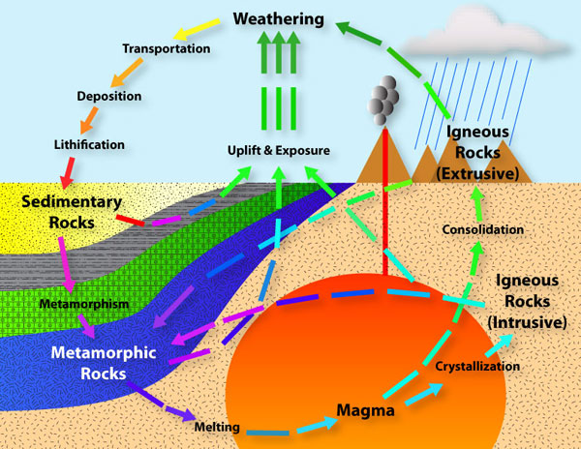

Slide 32
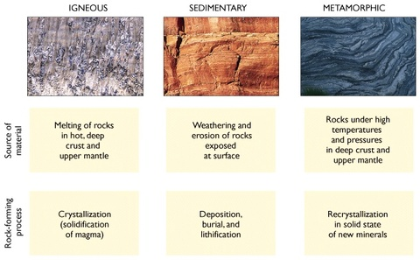
Rock types and processes

Slide 33
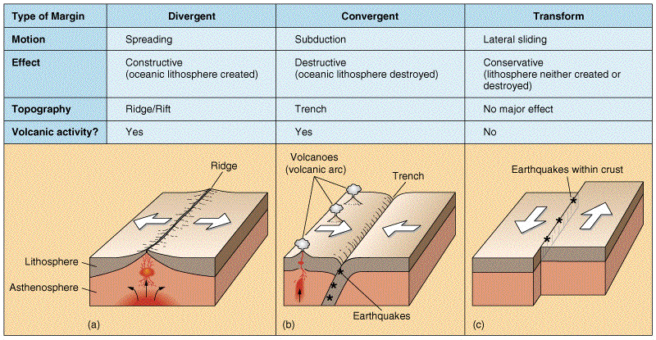
Tectonics- lithospheric plates move because of magma convection currents.
Interaction of the plates forms geologic areas (abiotic landforms) such as mountains, valleys, deep sea vents, coastlines, rift valleys.
Notes:
Plate boundary movement is often attributed to changes in evolution of a species depending on their isolation, orientation on earth, distance to equator, soil types→ which affects vegetation→ affects biotic elements living there!

Slide 34
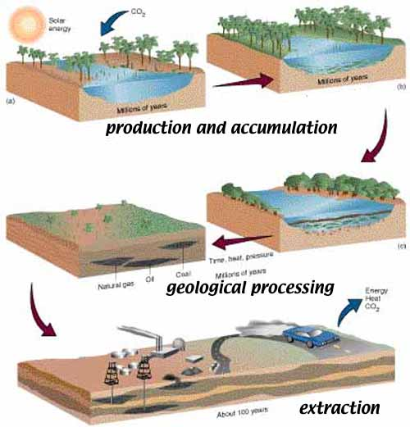
Geology and Fossil Fuels
It’s important to note this connection of carbon cycle and geologic cycle
and how a natural sequester of carbon is combusted for energy purposes. This then increases the amount of CO2 thus amplifying the greenhouse effect and amplifying the evaporation of water on earth. 3 cycle disruption from one activity…!
Keep in mind how long this process takes and does this happen with EVERY living thing that decays?
It’s important to understand that:

Slide 35
Any Questions?

